Slide 1
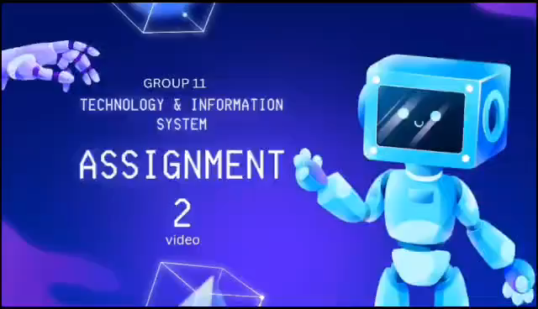
ASSIGNMENT 2: VIDEO
SEC1 GROUP 11

